Slide 1
Search for Top Squarks via All-hadronic Decay Channels with Heavy Object Tagging
Matthew Kilpatrick
Doctoral Candidate
Rice University

Slide 2
Outline
Standard Model
What is it?
Dark Matter
Why SUSY?
Compact Muon Solenoid
Different methods of detection
All-hadronic Top Squark Search
Kinematic Variables
Search region design
Background estimation

Slide 3
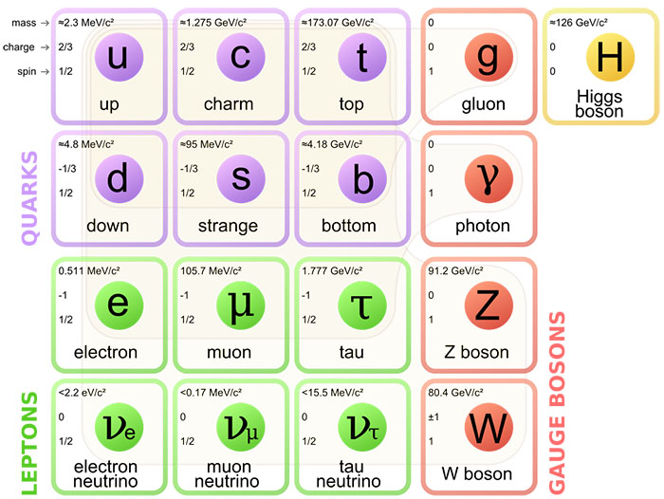
Standard Model
What can the Standard Model do?
All current predictions have been confirmed
4 fundamental forces
3 generations of quarks/leptons
Standard Model can’t explain:
Hierarchy Problem
Dark matter
Grand Unified Theory

Slide 4

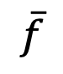
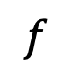
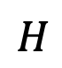
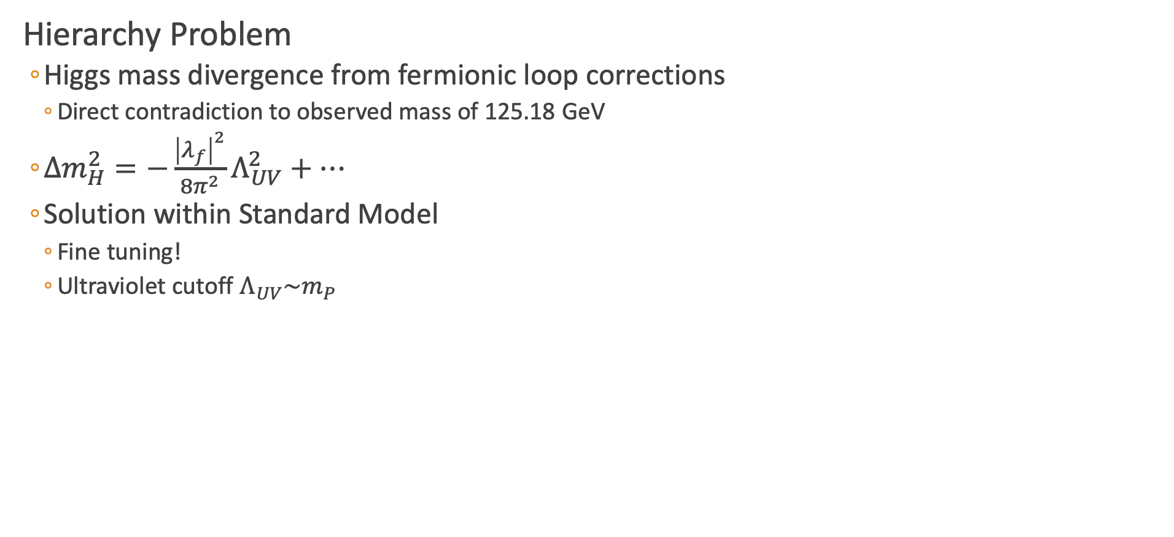
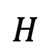
Hierarchy Problem
Hierarchy Problem
Higgs mass divergence from fermionic loop corrections
Direct contradiction to observed mass of 125.18 GeV
$Δm_{H}^{2}=−\frac{{\left|λ_{f}\right|}^{2}}{8π^{2}}Λ_{UV}^{2}+⋯$
Solution within Standard Model
Fine tuning!
Ultraviolet cutoff $Λ_{UV}\sim m_{P}$
$$f$$
$$H$$
$$H$$
$$\overline{f}$$

Slide 5
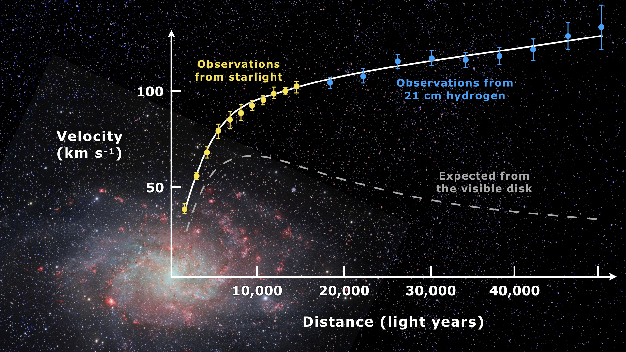
Dark Matter
Galactic Velocit Curves (Messier 33)
Radial velocity of galaxies is large
Not explainable with visible matter and current gravitational theories
Either:
Alternative theory of gravity
“Dark matter” interacting gravitationally
Gravitational Lensing
Mass curves spacetime
Deforms galaxies that move through
Use a gravitational lens methods to find total amount of matter
Disagrees with amount of visible matter
[1]
Notes:
Explain with a modified Newtonian gravity at low accelerations or Dark Matter

Slide 6
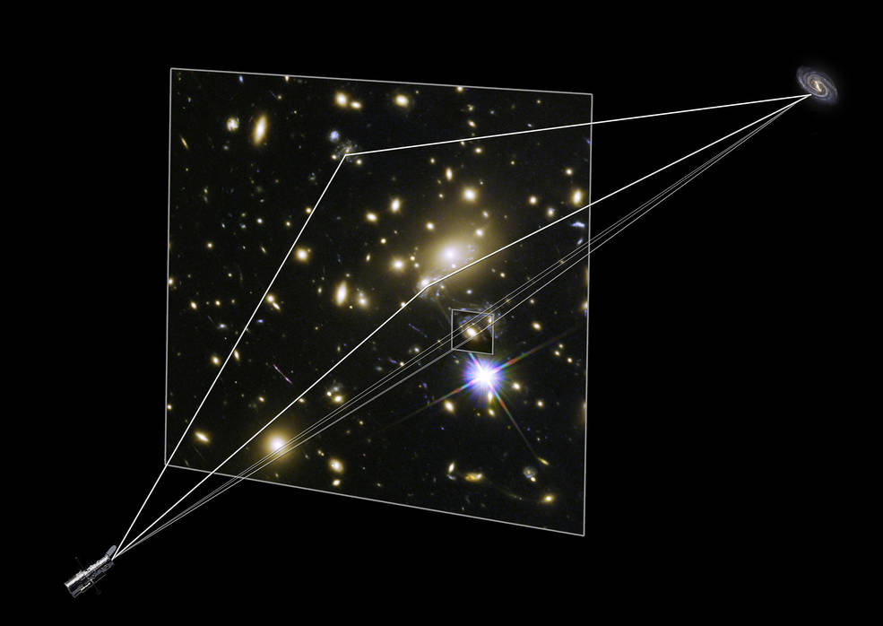
Dark Matter
Galactic Velocit Curves (Messier 33)
Radial velocity of galaxies is large
Not explainable with visible matter and current gravitational theories
Either:
Alternative theory of gravity
“Dark matter” interacting gravitationally
Gravitational Lensing
Mass curves spacetime
Deforms galaxies that move through
Use a gravitational lens methods to find total amount of matter
Disagrees with amount of visible matter
[1] [2]

Slide 7
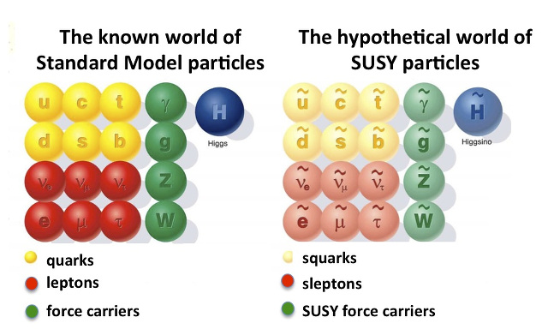
What does Supersymmetry potentially solve?
What is Supersymmetry?
Fermion-bosonic partnership
For every fermion there is a boson partner, and vice-versa
Exact same quantum numbers except
Where is the ”selectron”?
Supersymmetry must be broken!
What should we search for?

Slide 8
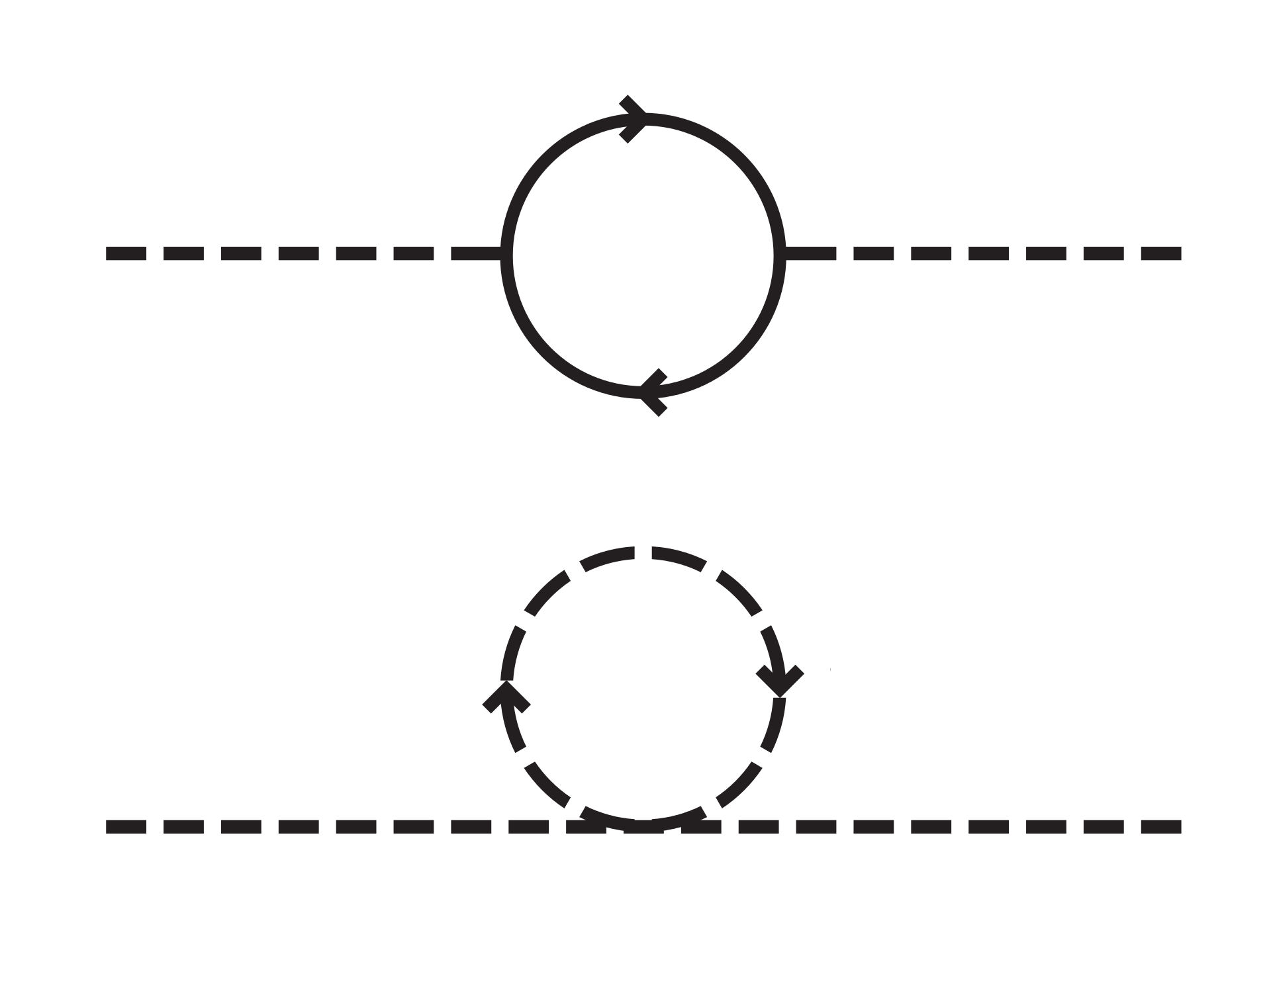
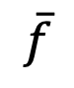
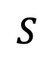
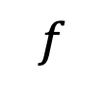
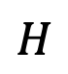
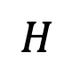
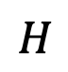
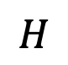
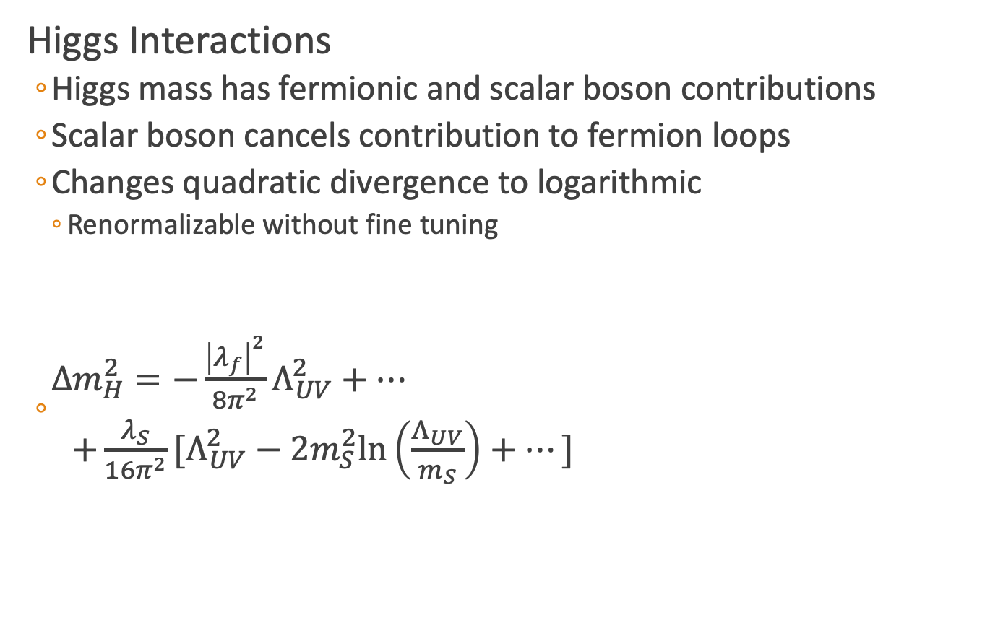
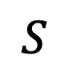
Hierarchy Solution
Higgs Interactions
Higgs mass has fermionic and scalar boson contributions
Scalar boson cancels contribution to fermion loops
Changes quadratic divergence to logarithmic
Renormalizable without fine tuning
$\begin{matrix}Δm_{H}^{2}=−\frac{{\left|λ_{f}\right|}^{2}}{8π^{2}}Λ_{UV}^{2}+⋯ \\ +\frac{λ_{S}}{16π^{2}}[Λ_{UV}^{2}−2m_{S}^{2}\text{ln}\left(\frac{Λ_{UV}}{m_{S}}\right)+⋯] \end{matrix}$
$$f$$
$$H$$
$$H$$
$$\overline{f}$$
$$S$$
$$S$$
$$H$$
$$H$$
Notes:
P_R = (-1)^3(B-L)+2s

Slide 9
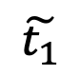
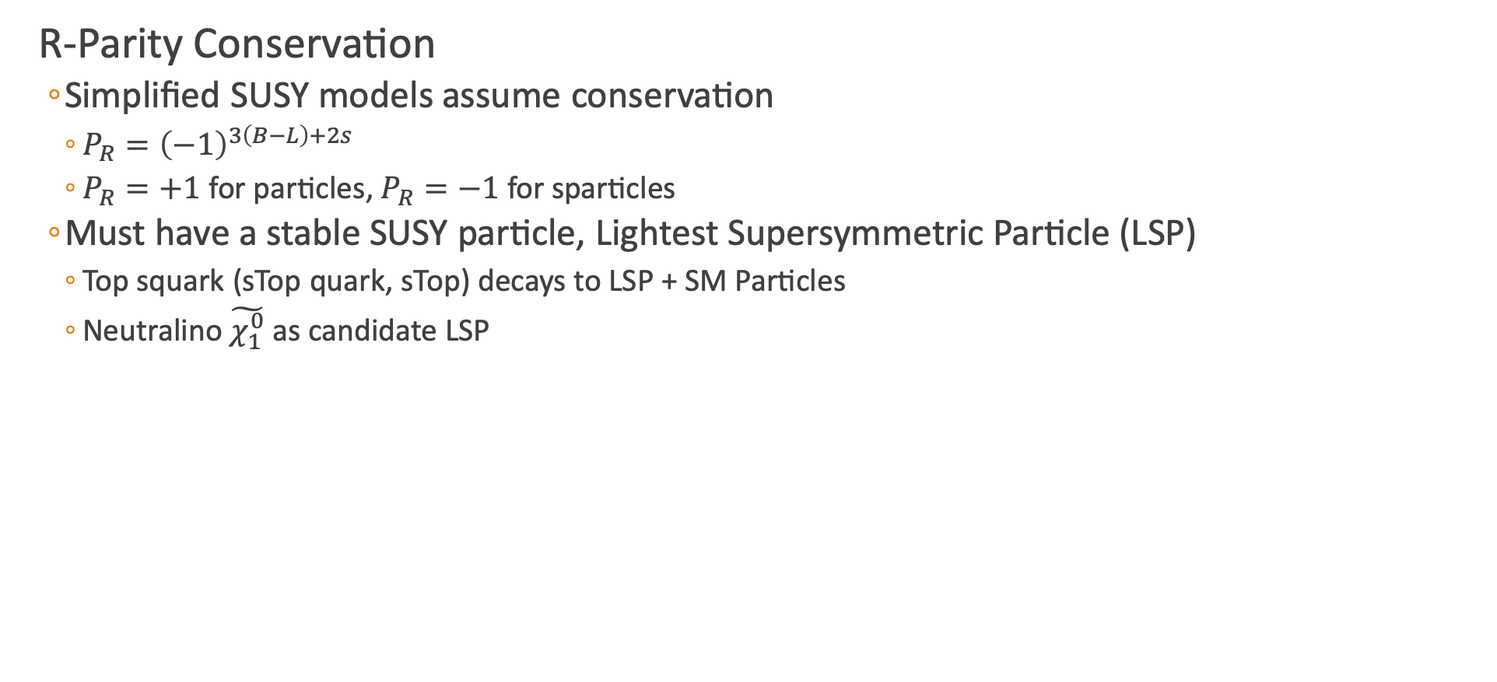
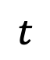
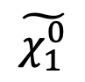
Dark Matter Candidate
R-Parity Conservation
Simplified SUSY models assume conservation
$P_{R}={\left(−1\right)}^{3\left(B−L\right)+2s}$
$P_{R}=+1$ for particles, $P_{R}=−1$ for sparticles
Must have a stable SUSY particle, Lightest Supersymmetric Particle (LSP)
Top squark (sTop quark, sTop) decays to LSP + SM Particles
Neutralino $\tilde{χ_{1}^{0}}$ as candidate LSP
$$t$$
$$\tilde{t_{1}}$$
$$\tilde{χ_{1}^{0}}$$

Slide 10
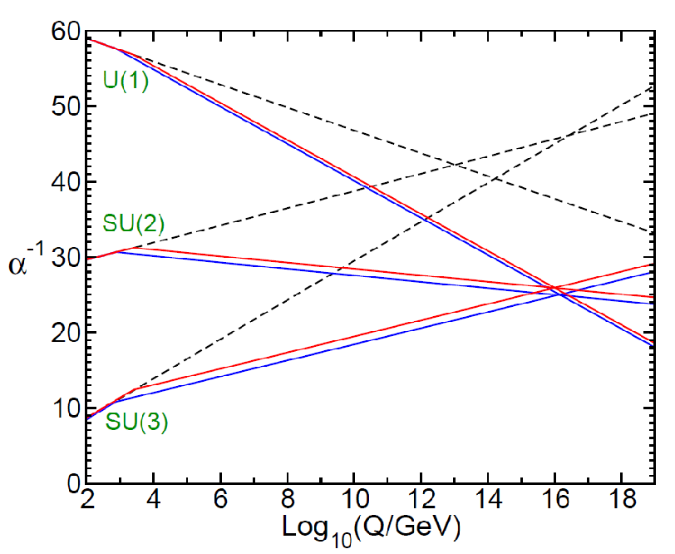
Grand Unified Theory
Unification of the Gauge Couplings
SUSY allows for EM, Weak, and QCD to unify at large energy scales
Notes:
Two loop renormalization group evolution of the inverse gauge couplings $α_{a}^{−1}(Q)$ in the SM (dashed) and MSSM (solid). In the MSSM, the sparticle masses are treated as a common threshold varied between 750 GeV and 2.5 TeV.

Slide 11
Outline
Standard Model
What is it?
Dark Matter
Why SUSY?
Compact Muon Solenoid
Different methods of detection
All-hadronic Top Squark Search
Kinematic Variables
Search region design
Background estimation

Slide 12
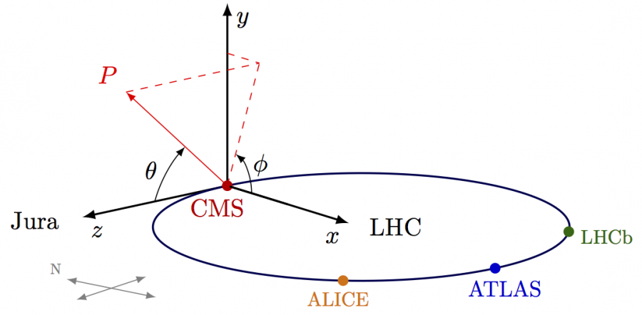
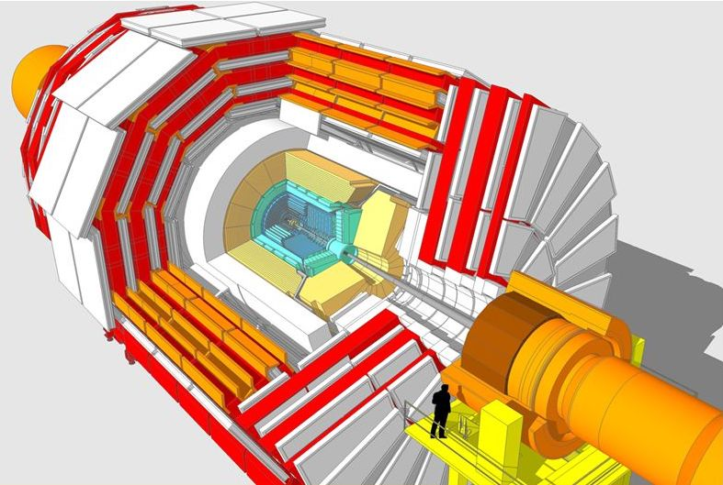
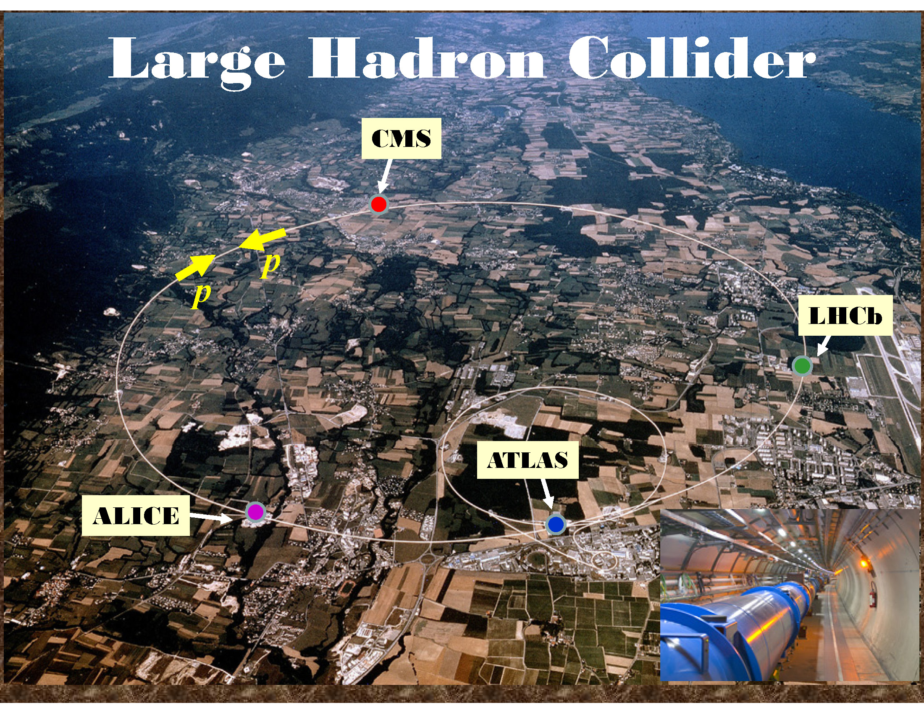
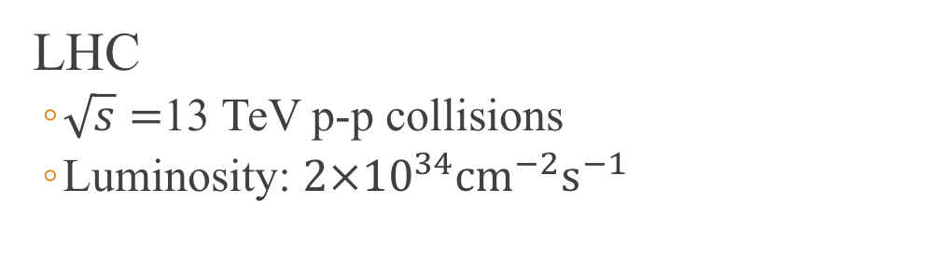
Compact Muon Solenoid (CMS)
LHC
$\sqrt{s}=$13 TeV p-p collisions
Luminosity: $2×{10}^{34}{\text{cm}}^{−2}{\text{s}}^{−1}$

Slide 13
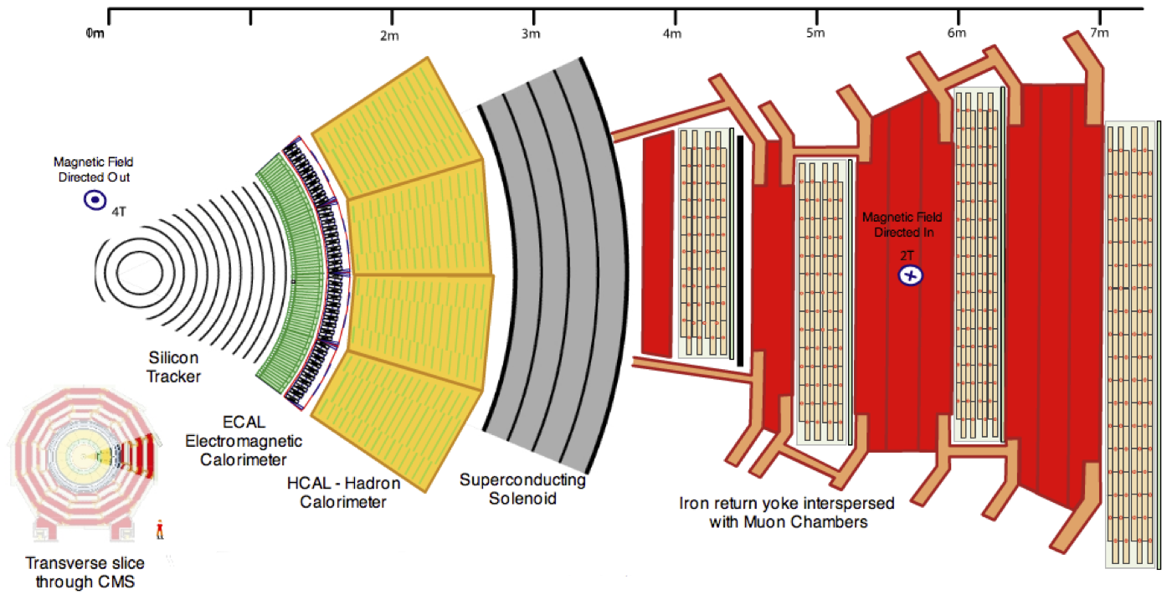
CMS Detector

Slide 14
Muon Interaction

Slide 15
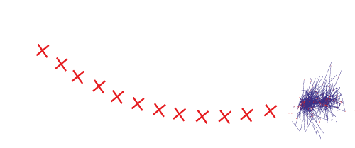
Electron Interaction

Slide 16

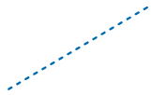
Photon Interaction

Slide 17
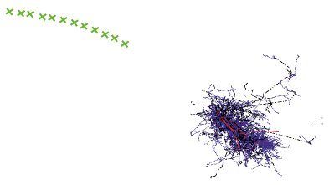
Charged Hadron Interaction

Slide 18
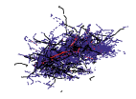

Neutral Hadron Interaction

Slide 19
Outline
Standard Model
What is it?
Dark Matter
Why SUSY?
Compact Muon Solenoid
Different methods of detection
All-hadronic Top Squark Search
Kinematic Variables
Search region design
Background estimation

Slide 20
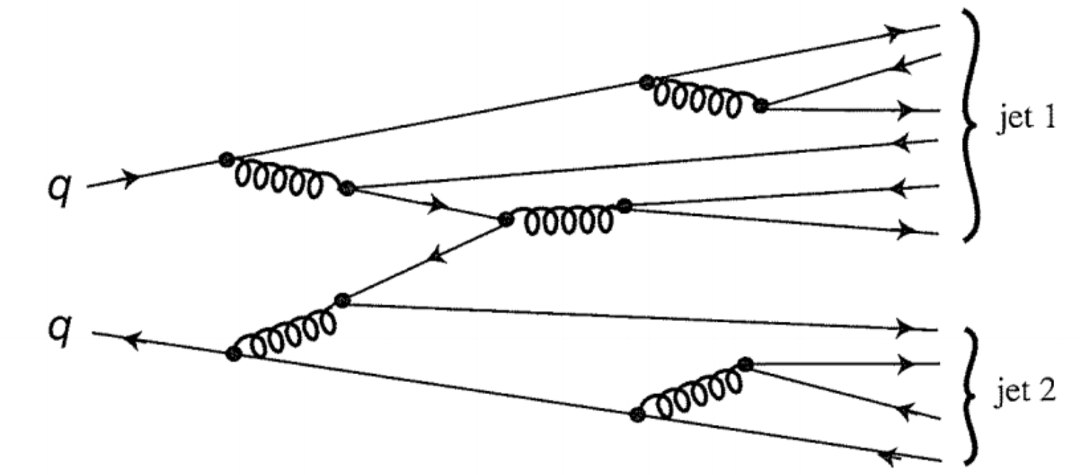
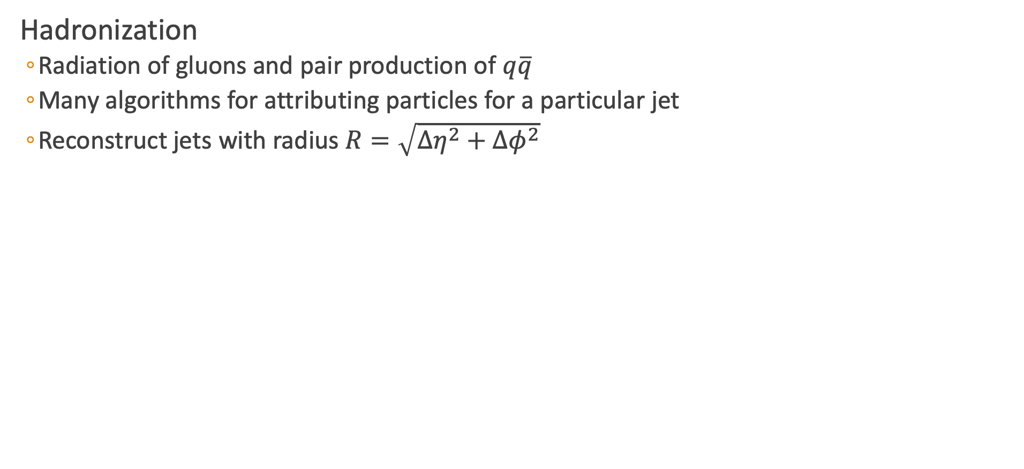
Jet Reconstruction
Hadronization
Radiation of gluons and pair production of $q\overline{q}$
Many algorithms for attributing particles for a particular jet
Reconstruct jets with radius $R=\sqrt{Δη^{2}+Δφ^{2}}$

Slide 21
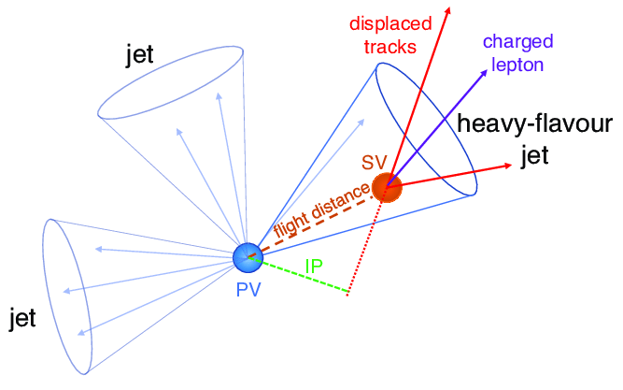
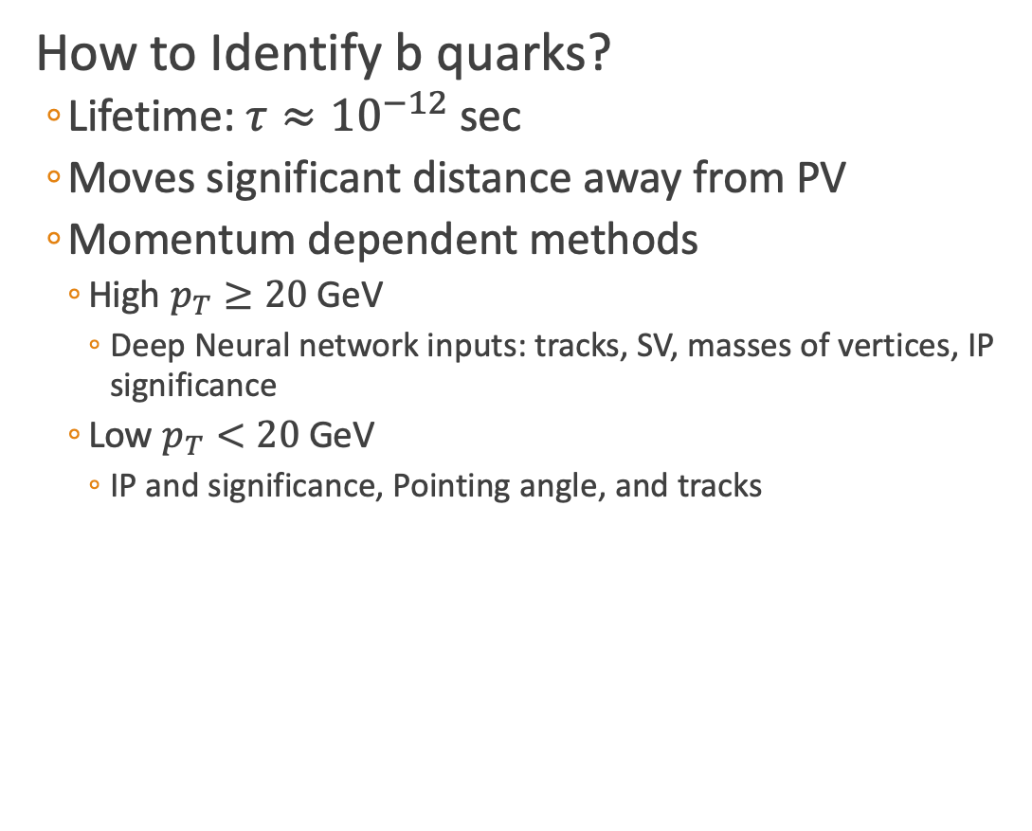
B Tagging
How to Identify b quarks?
Lifetime: $τ≈{10}^{−12}$ sec
Moves significant distance away from PV
Momentum dependent methods
High $p_{T}≥20$ GeV
Deep Neural network inputs: tracks, SV, masses of vertices, IP significance
Low $p_{T}<20$ GeV
IP and significance, Pointing angle, and tracks

Slide 22
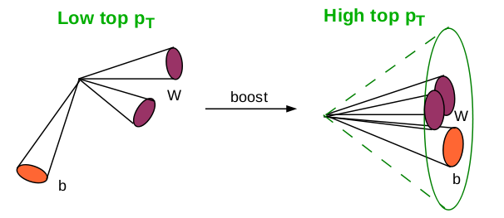
Heavy Object Tagging
Different Types of Top Reconstruction
Resolved tops
Can distinguish each individual jet of the top decay
Three jets with invariant mass of 100-250 GeV
Merged top/W
Boosted jets

Slide 23
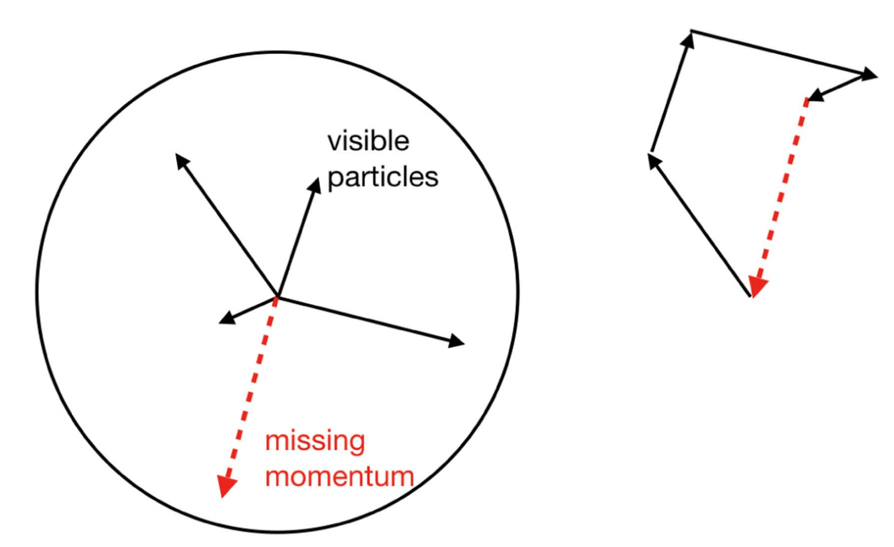
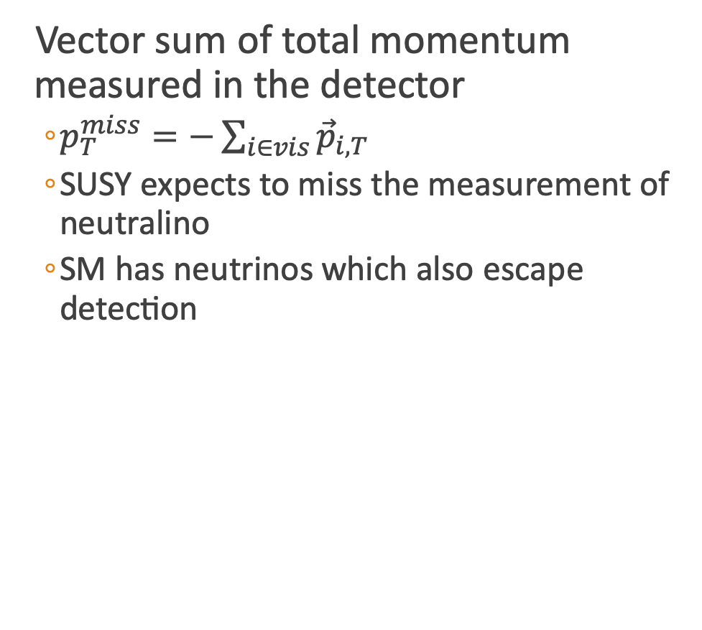
Missing Transverse Momentum
Vector sum of total momentum measured in the detector
$p_{T}^{miss}=−\sum_{i∈vis}{{\vec{p}}_{i,T}}$
SUSY expects to miss the measurement of neutralino
SM has neutrinos which also escape detection
[1]

Slide 24
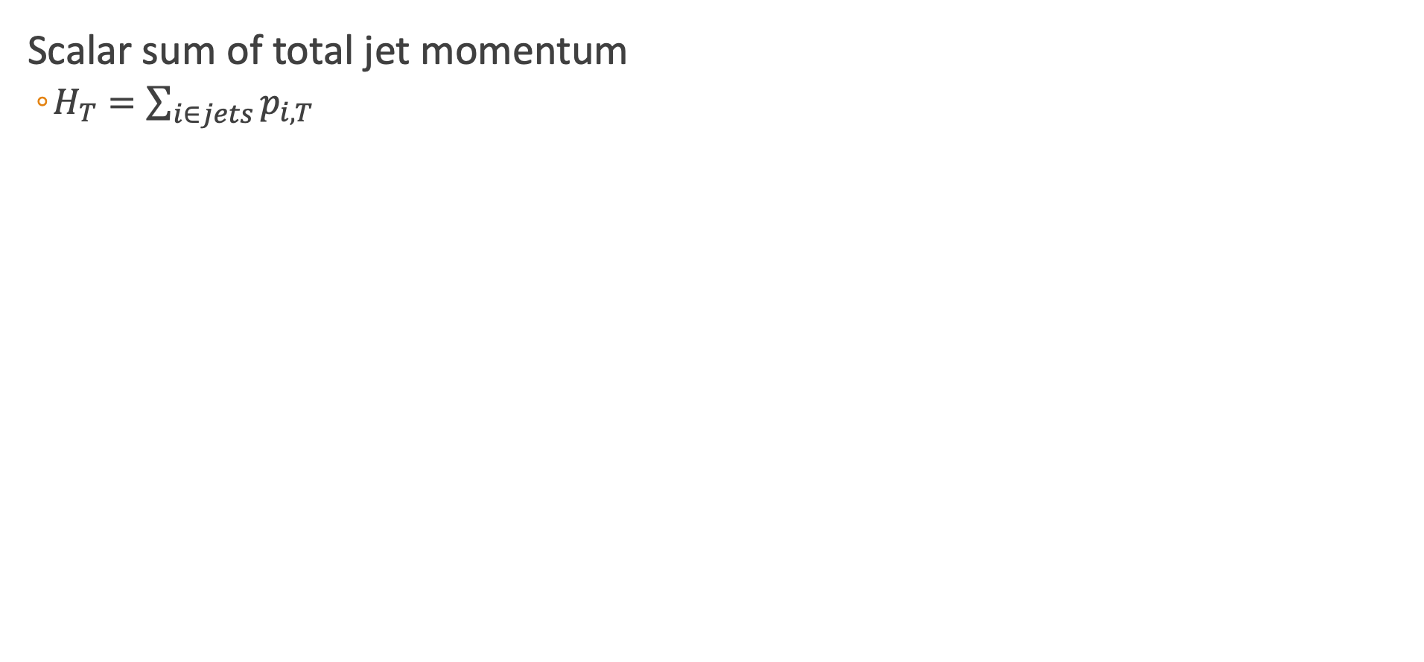
$$H_{T}$$
Scalar sum of total jet momentum
$H_{T}=\sum_{i∈jets}{p_{i,T}}$

Slide 25
Electron and Muon Identification

Slide 26
Tau Identification

Slide 27
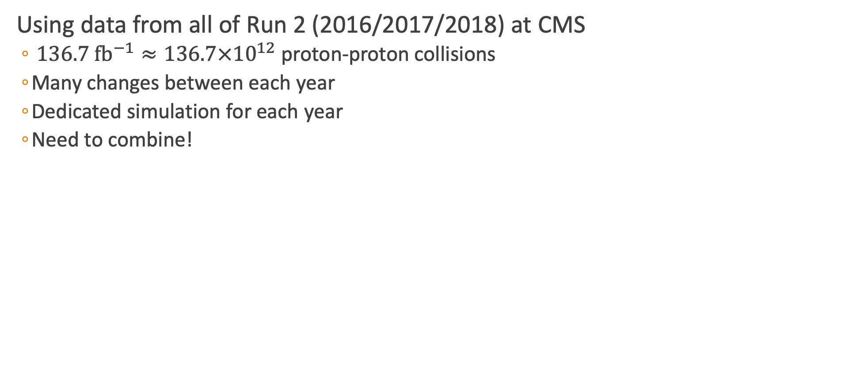
Data Methods
Using data from all of Run 2 (2016/2017/2018) at CMS
$136.7 {\text{fb}}^{−1}≈136.7×{10}^{12}$ proton-proton collisions
Many changes between each year
Dedicated simulation for each year
Need to combine!

Slide 28
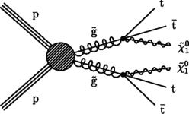
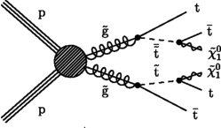
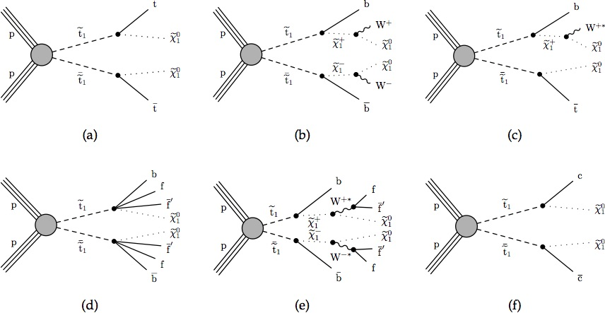
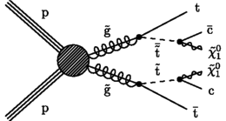
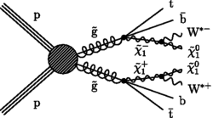
Simplified SUSY Models
Looking at inclusive models for a most general stop search
Gluino Mediated Stop Production
Direct Stop Production

Slide 29
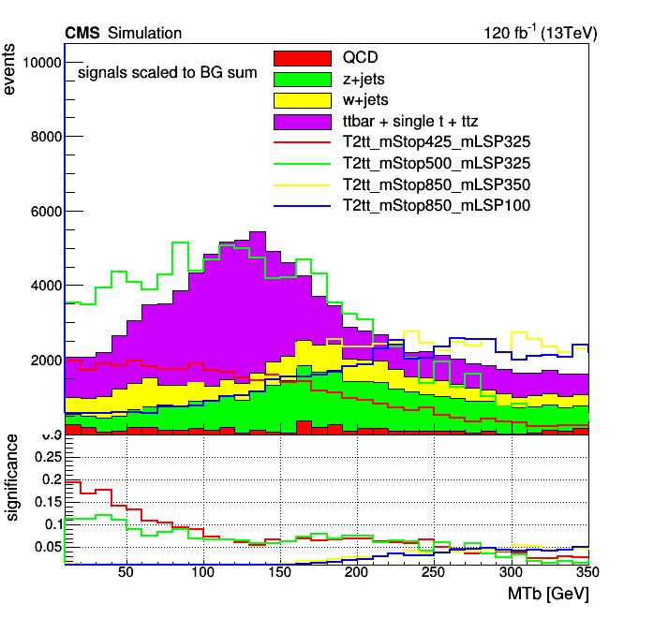
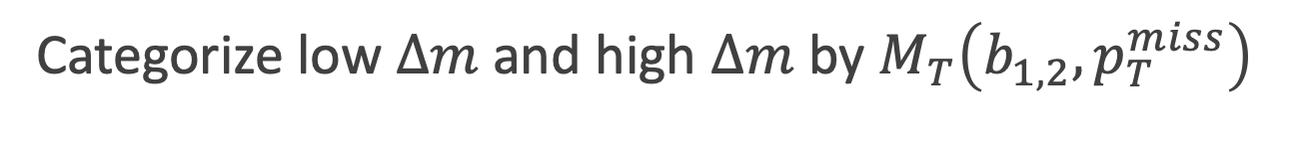
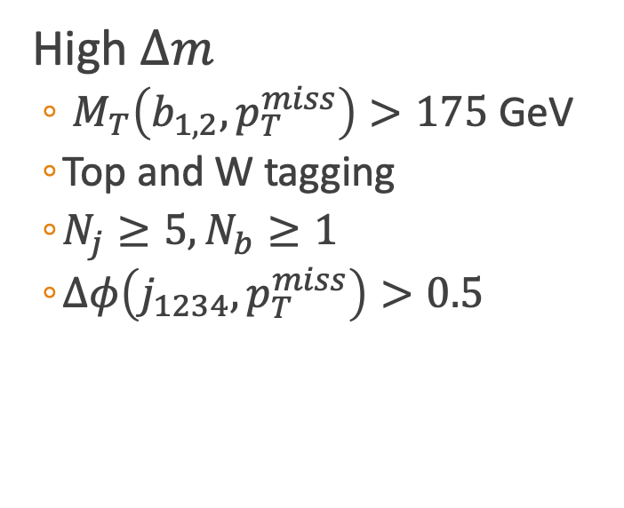

Search Strategy
Categorize low $Δm$ and high $Δm$ by $M_{T}\left(b_{1,2},p_{T}^{miss}\right)$
Low $Δm$
$M_{T}\left(b_{1,2},p_{T}^{miss}\right)<175$ GeV
Veto Tops and W
ISR Tagging
Soft-b tagging
$N_{j}≥2$
$Δφ\left(j_{1},p_{T}^{miss}\right)>0.5, Δφ\left(j_{23},p_{T}^{miss}\right)>0.15$
$\frac{p_{T}^{miss}}{\sqrt{H_{T}}}>10$
High $Δm$
$M_{T}\left(b_{1,2},p_{T}^{miss}\right)>175$ GeV
Top and W tagging
$N_{j}≥5,N_{b}≥1$
$Δφ\left(j_{1234},p_{T}^{miss}\right)>0.5$

Slide 30


Targeted Search Regions
Looking in low and high $Δm$ regions
Top Squark: $Δm=m_{\tilde{t}}−m_{\tilde{χ_{1}^{0}}}$
Gluino: $Δm=m_{\tilde{g}}−m_{\tilde{χ_{1}^{0}}}$
Search Regions
Compressed (low $Δm$)
Uncompressed (high $Δm$)
183 Search regions → 53 low + 130 high

Slide 31


Lost Lepton Background
Standard Model Background
$t\overline{t},W+jets, tW, ttW$
Causes
Lepton fails kinematic cuts
Out of detector acceptance
How to estimate for all of Run 2?

Slide 32

Compare Inclusive Regions
Regions with only low or high $Δm$

Slide 33

Transfer Factor Methods
LL Contribution
Control region (electron/muon): $N_{lep}=1, M_{T}\left(l,p_{T}^{miss}\right)<100$ GeV
Search region: $N_{lep}=0$
$N_{pred}^{LL}=\frac{N_{MC}(0l)}{N_{MC}(1l)}∙N_{data}(1l)$
$TF_{LL}=\begin{matrix}TF_{LL}^{CR−SR}×TF_{LL}^{SR−extrap} \\ \frac{N_{MC}(0l)(N_{j},N_{b},p_{T}^{miss})}{N_{MC}(1l)(N_{j},N_{b},p_{T}^{miss})}×\frac{N_{MC}(1l)(N_{j},N_{b},p_{T}^{miss},N_{t},N_{res},N_{W})}{N_{MC}(0l)(N_{j},N_{b},p_{T}^{miss})}\end{matrix}$
Transfer Factor

Slide 34
Transfer Factor Methods
LL Contribution
Control region (electron/muon): $N_{lep}=1, M_{T}\left(l,p_{T}^{miss}\right)<100$ GeV
Search region: $N_{lep}=0$
$N_{pred}^{LL}=\frac{N_{MC}(0l)}{N_{MC}(1l)}∙N_{data}(1l)$
$TF_{LL}=\begin{matrix}TF_{LL}^{CR−SR}×TF_{LL}^{SR−extrap} \\ \frac{N_{MC}(0l)(N_{j},N_{b},p_{T}^{miss})}{N_{MC}(1l)(N_{j},N_{b},p_{T}^{miss})}×\frac{N_{MC}(1l)(N_{j},N_{b},p_{T}^{miss},N_{t},N_{res},N_{W})}{N_{MC}(0l)(N_{j},N_{b},p_{T}^{miss})}\end{matrix}$
Transfer Factor

Slide 35


Example LL Prediction

Slide 36


Z to Invisible
Events with jets and a Z decaying to two neutrinos
Large $H_{T}$ and $p_{T}^{miss}$, similar to signal
Control Region
$Z→ll+\text{jets}\text{: }R_{Z}$(Z Normalization factor)
Use in low mass $N_{b} \text{and} N_{SV}$
Calculate $t\overline{t}$ normalization $R_{t}$
Photon + jets: $S_{γ}$($p_{T}^{miss}$ shape weight)
Use in low mass $N_{b} \text{and} N_{j}$
Reconstructed $Z \text{or} γ$ is added to $p_{T}^{miss}$ for $Z→ν\overline{ν}$
$$N_{pred}^{Z→ν\overline{ν}}=N_{MC}^{Z→ν\overline{ν}}∙R_{Z}{∙S}_{γ}$$

Slide 37





Comparison of Z Normalization for Muons

Slide 38





Photon Shape Corrections

Slide 39





Comparison of Normalization

Slide 40


QCD Background
Missing Energy from the mismeasurement of jets
QCD Estimation used Transfer Factor method where:
Control Region defined regions with $Δφ(j_{123},Ɇ$) < 0.1
Search Region
Low $Δm:\left|Δφ\left(j_{1},Ɇ\right)\right|>0.5, \left|Δφ\left(j_{23},Ɇ\right)\right|>0.15$
High $Δm:ΔΦ(j_{1234},Ɇ)>0.5$
Transfer Factor
$N_{pred}^{QCD}=\frac{N_{MC}^{QCD}\left(SR\right)}{N_{MC}^{QCD}\left(CR\right)}∙(N_{data}−N_{MC}^{non−QCD})$
Take MC events and do smearing (from 2 leading jets)
Statistical Uncertainty for the TF
Increasing the effective luminosity with a method called “local smearing”
$$TF_{QCD}=\begin{matrix}\frac{N_{MC}\left(SR\right)(N_{j},N_{b},p_{T}^{miss})}{N_{MC}(Δφ_{123}<0.1)(N_{j},N_{b},p_{T}^{miss})}× \\ \frac{N_{MC}(SR)(N_{j},N_{b},p_{T}^{miss},N_{t},N_{res},N_{W})}{N_{MC}(SR)(N_{j},N_{b},p_{T}^{miss})}\end{matrix}$$
Transfer Factor

Slide 41

QCD Smearing Method
Methods based on the jet response (JR) function
Parameterize jet reconstruction
Binned in $p_{T}$ and jet flavor
Local Smearing
Using centrally produced MC, generate an ensemble of smeared event with new reco jet $p_{T}$
Consider the two leading jets
Start at JR for standard MC ( )
Sample in small window ( )
Recalculate variables
Small window $→$ does not bias jet quantities
CMS Work in progress
Probability

Slide 42


QCD Control Region Comparison

Slide 43


Rare Background
3 lepton channels to validate $ttZ$ contribution
Also contribution from diboson, WW, WZ, and ZZ

Slide 44
Validation Region
Confirm Methods in region with only SM Samples

Slide 45

Low DM Validation

Slide 46

High DM Validation

Slide 47

Higgs Combined Tool Statistics
Method for getting limits on Data, signal, and background
Likelihood function
$ℒ\left(μ,θ\right)=\prod_{i}{\frac{{\left[μ∙s_{i}\left(θ\right)+b_{i}\left(θ\right)\right]}^{n_{i}}}{n_{i}!}e^{−\left[μ∙s_{i}\left(θ\right)+b_{i}\left(θ\right)\right]}}\prod_{κ}{e^{−\frac{1}{2}θ_{κ}^{2}}}$
${\tilde{q}}_{μ}=−2\text{ln}\frac{ℒ\left(μ,{\hat{θ}}_{μ}\right)}{ℒ\left(μ,θ\right)}$
Calculate the confidence levels for each signal region
$p_{μ}=P\left({\tilde{q}}_{μ}≥{\tilde{q}}_{μ}^{obs} | \text{signal}\text{+}\text{background}\right)=\int_{{\tilde{q}}_{μ}^{obs}}^{∞}{f\left({\tilde{q}}_{μ} | μ,{\hat{θ}}_{μ}^{obs}\right)d{\tilde{q}}_{μ}}$
$1−p_{μ}=P\left({\tilde{q}}_{μ}≥{\tilde{q}}_{μ}^{obs} | \text{background}\text{-}\text{only}\right)=\int_{{\tilde{q}}_{μ}^{obs}}^{∞}{f\left({\tilde{q}}_{μ} | 0,{\hat{θ}}_{0}^{obs}\right)d{\tilde{q}}_{μ}}$
$CL_{s}\left(μ\right)=\frac{p_{μ}}{1−p_{b}}$
Look for $CL_{s}=0.05$
But how do we input all of this?

Slide 48

Datacard Calculation

Slide 49
Limits

Slide 50

Limits

Slide 51
Backup

Slide 52



${\tilde{t}}_{1}$: Dynamic Reason to be at bottom of sParticles
Quark left and right superpartners can strongly mix to form mass eigenstates
$M_{\tilde{t_{1}}}^{2}=\left(\begin{matrix}{\tilde{M}}_{Q_{3}}^{2}+M_{t}^{2}+M_{Z}^{2}\left(\frac{1}{2}−\frac{2}{3}\sin^{2}{θ_{W}}\right)cos2β & v\left(a_{t}^{∗}sinβ−μy_{t}cosβ\right) \\ v\left(a_{T}^{∗}sinβ−μy_{t}cosβ\right) & {\tilde{M}}_{{\overline{u}}_{3}}^{2}+M_{t}^{2}+\frac{2}{3}M_{Z}^{2}\sin^{2}{θ_{W}cos2β}\end{matrix}\right)$
Strong mixing in the stop sector
Could lead to ${\tilde{t}}_{1}$being the lightest squark
Notes:
Y_t is the Yukawa coupling(interaction between a scalar field and Dirac field),

Slide 53


The Tracker Detector
Outer Tracker
Active area: 200 ${\text{m}}^{2}$, 15148 modules
10 layers in barrel region
9 + 3 in inner disks and endcaps
Analog readout
Phase 1 Pixel Tracker
4 barrel layers
3 endcap disks on each side
124 million pixel channels
Digital Readout

Slide 54




Phase 1 Pixels
Replaced in winter 2016/2017
Approximately 1 m long
Designed for peak luminosity of $2.5×{10}^{34}{ \text{cm}}^{−2}{\text{s}}^{−1}$ with 50 ns bunch crossings
Analog $→$ digital
New data acquisition (DAQ)
DCDC powering
${\text{CO}}_{2}$ cooling
Light weight
Cost effective
Layer 1 closer to beam line
43 mm to 30 mm
Layer 4 extends to 160 mm

Slide 55


Anti-kT Algorithm
Distance calculation
$d_{ij}=\text{min}(k_{Ti}^{−2},k_{Tj}^{−2})\frac{{\left(y_{i}−y_{j}\right)}^{2}+{\left(φ_{i}−φ_{j}\right)}^{2}}{R^{2}}$
$d_{iB}=k_{Ti}^{−2}$
Infrared safe
Circular jet area
Notes:
Infrared safe: reconstruction is unaffected by soft radiation of photons
Jet area: unaffected by soft radiation, low pT photons will not have a min from the above
P = 1: Inclusive kT algorithm
P = 0: Inclusive Cambridge/Aachen algorithm

Slide 56

Stop Cross Section
Cross section-probability that two particles will collide and react a certain way

Slide 57

Baseline Selection
Lepton Selection
Veto ID electron: $p_{T}>5$ GeV, $\left|η\right|<2.5$
Loose muon: $p_{T}>5$ GeV, $\left|η\right|<2.5$
IsoTrack: cut based charged PF candidate
TauPOG: $p_{T}>20$ GeV, $\left|η\right|<2.4$, medium working point
$N_{j}\left(p_{T}>20 \text{GeV}\right)≥2,\left|η\right|<2.4$
$Δφ\left(j_{1},p_{T}^{miss}\right)>0.5,Δφ\left(j_{23},p_{T}^{miss}\right)>0.15$
$p_{T}^{miss}>250$ GeV
$H_{T}>300$ GeV
HEM Veto: $η\left[−3,−1.4\right], φ\left[−1.57,−0.87\right],p_{T}>20$ GeV applied to jets, electrons, and photons
Bjets: DeepCSV medium working point
W/Top: deepAK8 tight working point
Deep Resolved Top: tight working point
Scale Factors: PUWeights, BtagWeights, resTop/Top/W, soft btaggin, ISRWeights (2016), PrefireWeights (2016/2017) for all backgrounds

Slide 58

Low Mass Region

Slide 59

High Mass Region

Slide 60
Lost Lepton Inclusive Low DM

Slide 61
Lost Lepton Inclusive High DM

Slide 62

Z Normalization
Calculate the normalizations
$\left[\begin{matrix}Data_{on−Z} \\ Data_{off−Z}\end{matrix}\right]=\left[\begin{matrix}MC_{on−Z}(Z→ll) & MC_{on−Z}(t\overline{t}) \\ MC_{off−Z}(Z→ll) & MC_{off−Z}(t\overline{t})\end{matrix}\right]∙\left[\begin{matrix}R_{Z} \\ R_{T}\end{matrix}\right]$
Contributions from tZ, ttZ, WZ, and ZZ in Rz
Contributions from tW, ttW, and WW in Rt

Slide 63

Low DM Validation Region

Slide 64

High DM Validation

Slide 65
Datacard Calculation

Slide 66
Datacard Calculation

Slide 67
Datacard Calculation

Slide 68
Datacard Calculation

Slide 69
Example Calculation for Single Bin
Total yield of background
N=3042.65(LL)+7457.98(Znunu)+690.827(QCD)+0.390779(ttZ)+196.672(Diboson)
N=11388.52
Stat. Uncertainty = 0.0066(LL)+0.0027(Znunu)+0.03078(QCD)+0.10877(ttZ)+0.03485(Diboson)
Stat. Uncertainty = 68.40 (sum of weights squared)
Simple(independent) Syst. Uncertainty =

